Slide 1

STUDENT’S DETAIL
NAME: SHAISHTA ANJUM
SKILLSBUILD EMAIL ID: shaishta2002@gmail.com
COLLEGE NAME: SRI VENKATESHWARA COLLEGE OF ENGINEERING, BENGALURU
COLLEGE STATE: KARNATAKA
INTERNSHIP DOMAIN: ARTIFICIAL INTELLIGENCE
INTERNSHIP DATE: 12 JUNE 2023 TO 24 JUNE 2023

Slide 2
Mind Over Matter:
Analyzing Mental Fitness Levels with The Mental Health Fitness Tracker

Slide 3
What is Mental health?
Mental health is a state of well-being that involves how we think, feel, and act. It includes emotional, psychological, and social aspects. Good mental health enables coping with stress, maintaining healthy relationships, and overall well-being. It involves recognizing and addressing mental illnesses when necessary. Promoting mental health awareness is essential for a healthier and more supportive society.

Slide 4
Mental Fitness Tracker
An AI-powered Mental Fitness Tracker, is an innovative platform that utilizes advanced data analytics and artificial intelligence to analyze and predict the mental fitness levels of individuals from diverse countries, each grappling with different mental disorders. Through the obtained dataset, our tool aims to break new ground in mental health assessment by providing personalized insights. It utilizes regression techniques to provide insights into mental health and make predictions based on the available data.

Slide 5
AGENDA
Our project agenda is related to "Mental Fitness Tracker“. The agenda is to focus on analyzing and tracking mental fitness-related data, particularly focusing on the impact of mental disorders on Disability-Adjusted Life Years (DALY) for different countries over time.
The project's main agenda includes the following key objectives:
Data Integration: Merging two datasets related to mental health, DALY, and mental disorder prevalence to create a comprehensive dataset.
Data Visualization: Visualizing the relationship between mental fitness-related factors and DALY using heatmaps, pair plots, and line plots for yearwise variations across different countries.
Feature Selection: Selecting relevant features related to mental fitness from the dataset for analysis.

Slide 6
4.Model Training: Utilizing the Random Forest Regression model to predict DALY based on selected mental fitness-related features.
5.Model Evaluation: Assessing the performance of the Random Forest model using metrics like Mean Squared Error and R2 Score.
6.Real-Time Tracking (Example): Demonstrating how the trained model can be used for real-time tracking and prediction of mental fitness labels for new data points.
The primary aim of the project is to gain insights into mental health trends, identifying patterns in mental fitness data, and understanding how mental disorders can impact disability-adjusted life years in different countries. Additionally, the project focuses on exploring the relationships between different mental fitness-related factors and DALY and providing actionable information for mental health analysis and tracking purposes.

Slide 7
PROJECT OVERVIEW
The "Mental Fitness Tracker" project is a comprehensive analysis of mental health data, with a primary focus on understanding the impact of mental disorders on Disability-Adjusted Life Years (DALY) across different countries and various time periods. Through this project, we aim to shed light on the intricacies of mental well-being and its significance in overall health.
To achieve our objectives, we start by integrating datasets that provide information on DALY and the prevalence of mental disorders. By merging these datasets, we create a robust and interconnected source of data for our analysis.
Data visualization is a crucial aspect of our project. We employ heatmaps, pair plots, and interactive line plots to visually represent the correlations between different mental fitness factors and DALY. These visualizations help us identify patterns, trends, and variations in DALY over time and among diverse countries.

Slide 8
The core of our analysis lies in the application of the Random Forest Regression model. This machine learning technique allows us to predict DALY based on selected mental fitness-related features. Through model training and evaluation, we ensure the accuracy and reliability of our predictions.
Furthermore, the project includes a real-time tracking demonstration, illustrating how the trained model can predict the mental fitness label (DALY) for new data points. This feature showcases the practical applications of our findings.
The outcomes of the "Mental Fitness Tracker" project hold significant importance for mental health analysis and awareness. By providing valuable insights to mental health professionals and policymakers, we aim to contribute to the development of effective strategies and interventions. Moreover, by promoting mental health awareness and reducing stigma surrounding mental health issues, we aspire to create a more supportive and empathetic society that prioritizes mental well-being for all individuals.

Slide 9
The project's main objectives include creating an intuitive user interface that presents mental health insights and predictions in an easily understandable format, ensuring real-time usability, and addressing ethical considerations regarding data privacy and confidentiality. The Mental Fitness Tracker aims to empower individuals and healthcare professionals with personalized support and information, enabling better decision-making regarding treatment and support for mental health conditions. Moreover, the project sets the stage for potential future enhancements, collaborations, and advancements in the field of mental health analysis and prediction, contributing to a more compassionate and understanding society where mental well-being is a top priority.

Slide 10
WHO ARE THE END USERS of this project?
The end users of the Mental Fitness Tracker project's final product are likely to be individuals seeking insights into their mental fitness levels, mental health professionals, and healthcare organizations involved in the diagnosis and treatment of mental disorders. The platform will cater to a wide range of end users, including:
Individuals: The platform will provide personalized insights into an individual's mental fitness levels and potential mental health concerns. People can use the tool to gain a better understanding of their emotional well-being, identify areas of improvement, and take proactive steps to maintain good mental health.
Mental Health Professionals: Psychologists, psychiatrists, therapists, and counselors can utilize the Mental Fitness Tracker to assess their patients' mental health and track changes over time. The platform's predictive capabilities can aid in early intervention and personalized treatment plans for better patient outcomes.

Slide 11
3.Healthcare Organizations: Hospitals, clinics, and mental health facilities can integrate the Mental Fitness Tracker into their systems to enhance their mental health assessment and monitoring processes. The platform's data-driven insights can contribute to evidence-based practices and better resource allocation.
4.Researchers and Academics: The project's findings and methodologies can be valuable to researchers and academics in the field of mental health. The dataset and regression techniques employed can serve as a foundation for further studies and advancements in the area of mental health analysis and prediction.
Overall, the Mental Fitness Tracker aims to be a versatile tool that benefits individuals, mental health professionals, healthcare organizations, and the broader mental health research community, fostering a more proactive and comprehensive approach to mental health care.

Slide 12
YOUR SOLUTION AND ITS VALUE PROPOSITION
Solution: The Mental Fitness Tracker
The Mental Fitness Tracker is an advanced platform exclusively dedicated to analyzing and predicting the mental fitness levels of individuals from diverse countries, each facing unique mental disorders. Leveraging state-of-the-art regression techniques, this specialized tool offers personalized insights and support, enabling users to gain a profound understanding of their mental well-being.
Value Proposition:
Personalized Mental Fitness Assessment: The Mental Fitness Tracker provides personalized assessments of individuals' mental fitness levels, considering the intricate interplay between their unique backgrounds and specific mental disorders. This tailored approach allows users to gain deeper insights into their mental health, fostering self-awareness and empowering them to take proactive steps towards improvement.
Early Identification of Mental Health Concerns: With its predictive capabilities, the platform excels in early identification of potential mental health issues. Mental health professionals can leverage this feature to initiate timely interventions and design personalized treatment plans, contributing to better outcomes for individuals with mental disorders.

Slide 13
Data-Driven Precision: The Mental Fitness Tracker relies on sophisticated regression techniques to derive meaningful patterns and correlations within its specialized dataset. This data-driven precision enables mental health professionals and researchers to make informed decisions and develop targeted interventions, honing their focus on analyzing and predicting mental fitness levels.
Inclusive Global Perspective: With its focus solely on analyzing mental fitness levels and disorders from individuals across various countries, the platform embraces a truly global perspective. It considers cultural diversity and unique regional factors that impact mental health, ensuring a comprehensive approach to understanding mental fitness worldwide.
Enhanced Mental Health Support: Healthcare organizations can integrate the Mental Fitness Tracker to enhance mental health support services. The platform streamlines mental fitness assessment and continuous monitoring, facilitating personalized care and contributing to a higher quality of mental health services.
Advancing Mental Health Research: The Mental Fitness Tracker's specialized dataset and regression techniques present a valuable resource for researchers and academics in the field of mental health. By honing their research focus on mental fitness levels and disorders, the platform contributes to advancing knowledge and improving mental health diagnostics and care.

Slide 14
How did you customize the project and make it your own

Slide 15
In my provided code, there are several customizations made to analyze and visualize the dataset related to mental fitness tracking. These customizations involve data visualization, feature selection, model training, evaluation, and real-time tracking. Here's a summary of the customizations made in the code:
Feature Selection:
The code selects specific features related to mental fitness tracking from the dataset. These features are as follows:
Schizophrenia
Bipolar Disorders
Eating Disorders
Anxiety Disorders
Drug use Disorders
Depressive Disorders
Alcohol use Disorders

Slide 16
Data Visualization:
The code uses ‘matplotlib’ and ‘seaborn’ libraries to create data visualizations.
A heatmap is created to visualize the correlation between the slected features and the target variable ‘DALY’.
A pair plot is generated to show the relationship between different features.
Line plots are created using ‘plotly.express’ to visualize the yearwise variation in different mental fitness related factors for different countries.
Model Training and Evaluation:
The code trains a Random Forest Regression model using the ‘RandomForestRegression’ class from ‘sklearn.ensemble’.
The model is trained on the selected features and the target variable ‘DALY’.
The model’s performance is evaluated using Mean Squared Error (MSE) and R2 Score on the testing set.

Slide 17
Real Time Tracking (Example):
The code provides an example of real-time tracking using the trained Random Forest Regression model.
A new DataFrame (‘new_data’) is created with arbitrary values for the slected features.
The model then predicts the mental fitness label (DALY) for this new data point using the ‘predict’ method.
Data Cleaning and Manipulation:
The code performs data cleaning and manipulation tasks, such as setting proper column names, merging datasets, and splitting the data into training and testing sets.
Data Visualization Customization:
The ‘plotly.express’ library is used to create interactive and visually appealing line plots for the yearwise variation in different mental fitness-related factors for different countries.
The ‘plotly_dark’ template is used to set a dark theme for the plots.

Slide 18
MODELLING
This Mental Fitness Tracker uses only one model, which is the Random Forest Regression, and it is used in the following ways:
Importing Libraries:
The code starts by importing the necessary libraries, including pandas, sklearn, matplotlib, seaborn and plotly.express . These libraries are used for data manipulation, machine learning modelling, visualization and plotting.
Loading and Merging Datasets:
Two datasets are loaded from CSV files: daly.csv and pd.csv . The code ten merges these datasets based on common columns- Entity, Code and Year. The merged dataset is stored in the variable ‘df_merged’.

Slide 19
Feature Engineering:
The code selects relevant features for mental fitness tracking. The features selected are as follows:
Schizophrenia
Bipolar Disorders
Eating Disorders
Anxiety Disorders
Drug use Disorders
Depressive Disorders
Alcohol use Disorders
Data Visualization:
The code uses matplotlib and seaborn to create a heatmap of the correlation between the selected features and the target variable ‘DALY’ . It also creates a pair plot to visualize the relationships between different features.

Slide 20
Data Splitting:
The merges dataset is split into two sets: the feature set (‘X’) and the target variable (‘y’). X contains the selected mental fitness related features, and y contains the target variable ‘DALY’ (Disability-Adjusted Life Years).
Train-Test Split:
The data is further split into training and testing sets using train_test_split function from sklearn_model_selection. The training set (X_train and y_train) will be used to train the model, while the testing set (X_test and y_test) will be used to evaluate the model’s performance.
Random Forest Regression Model Training:
The code uses the ‘RandomForestRegression’ class from ‘sklearn.ensemble’ to create an instance of the Random Forest Resgression model. It is initialized with ‘n_estimators=100’ and ‘random_state=42’ ,meaning it will use 100 trees in the forest and set the random state reproducibility. The model is then trained on the training data using the ‘fit’ method.

Slide 21
Model Evaluation:
After training, the model is used to make predictions on the testing set ‘X_test’ using the ‘predict’ method. The Mean Squared Error (MSE) and R2 Score are calculated to evaluate the model's performance.
Real Time Tracking (Example):
The code provides an example of real-time tracking using the trained Random Forest Regression model. It creates a new DataFrame (‘new_data’) with some arbitrary values for the selected features. The model then predicts the mental fitness label (DALY) for this new data point using the ‘predict’ method.
Data Visualization (Continued):
The code uses plotly.express to create various line plots to visualize the yearwise variation in different mental fitness-related factors (Schizophrenia, Bipolar disorder, Eating disorders, Drug use disorder, Anxiety disorder, Depressive disorder, Alcohol use disorder) for different countries.

Slide 22
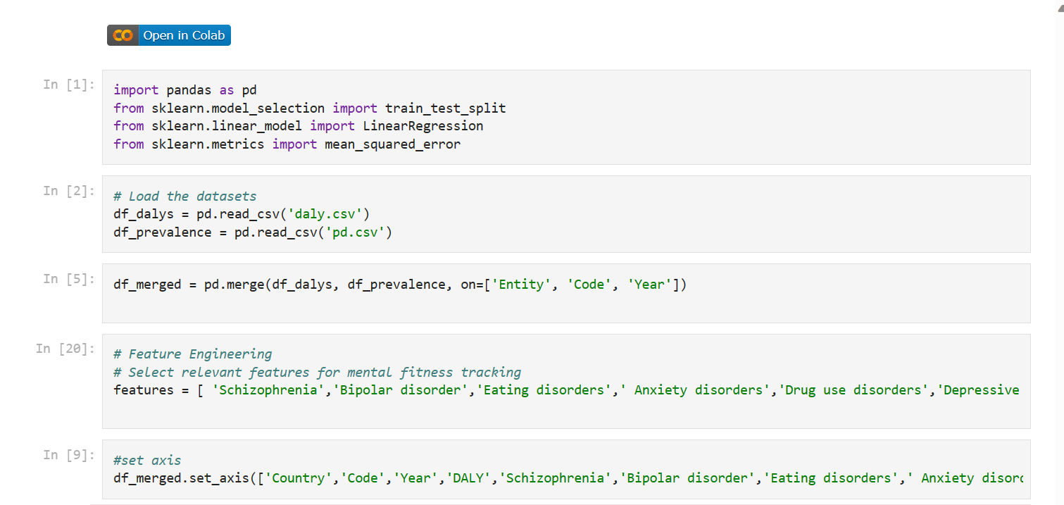
screenshots

Slide 23
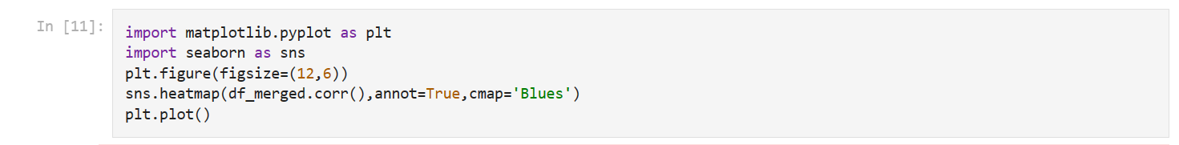
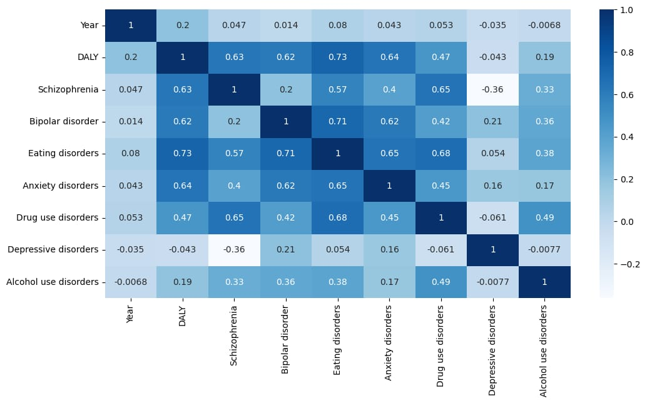

Slide 24
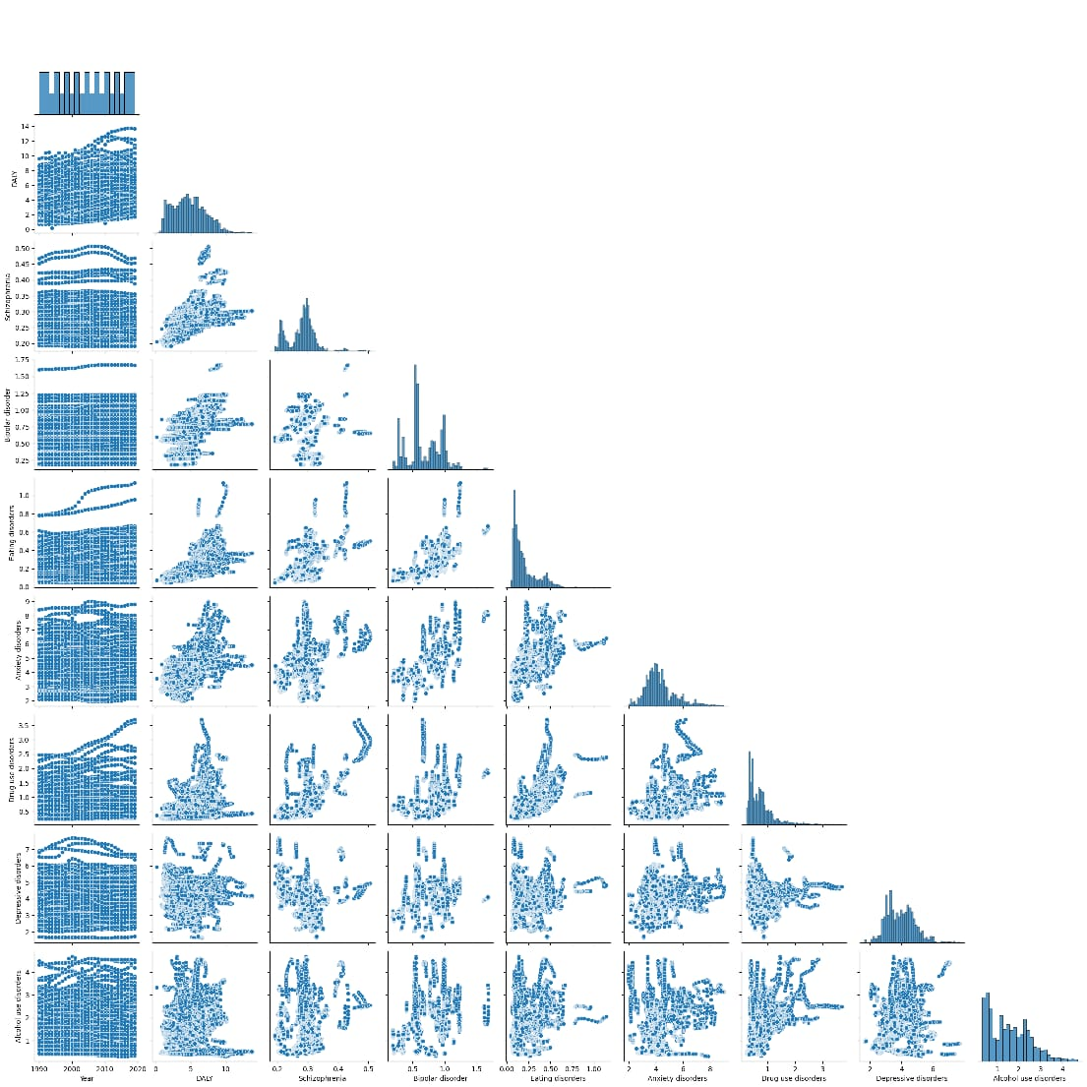

Slide 25
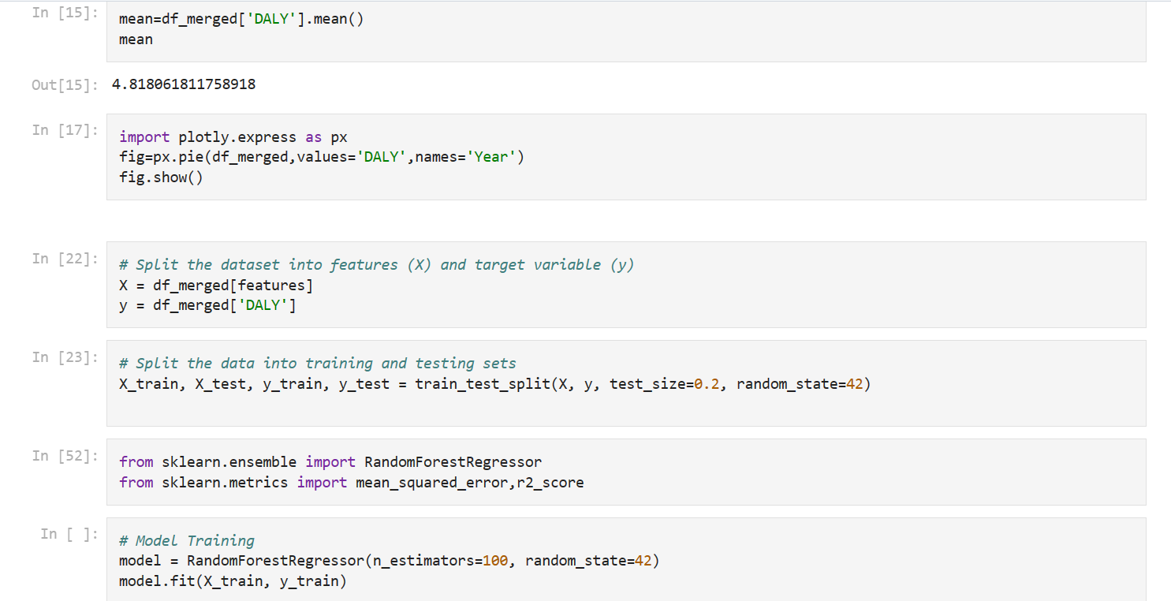

Slide 26
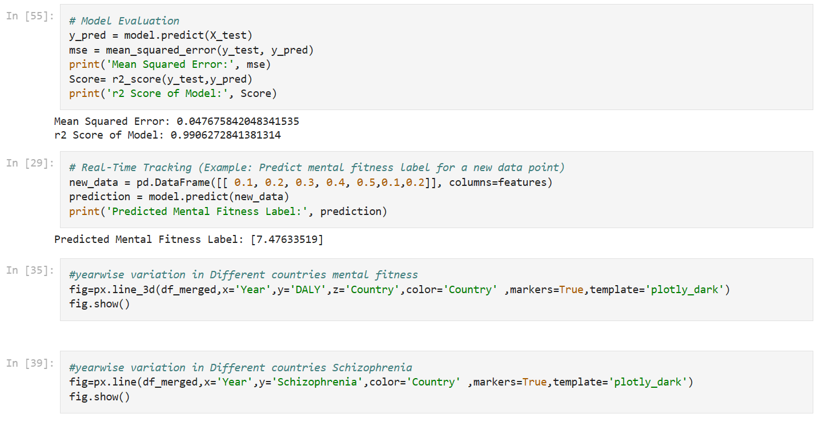

Slide 27
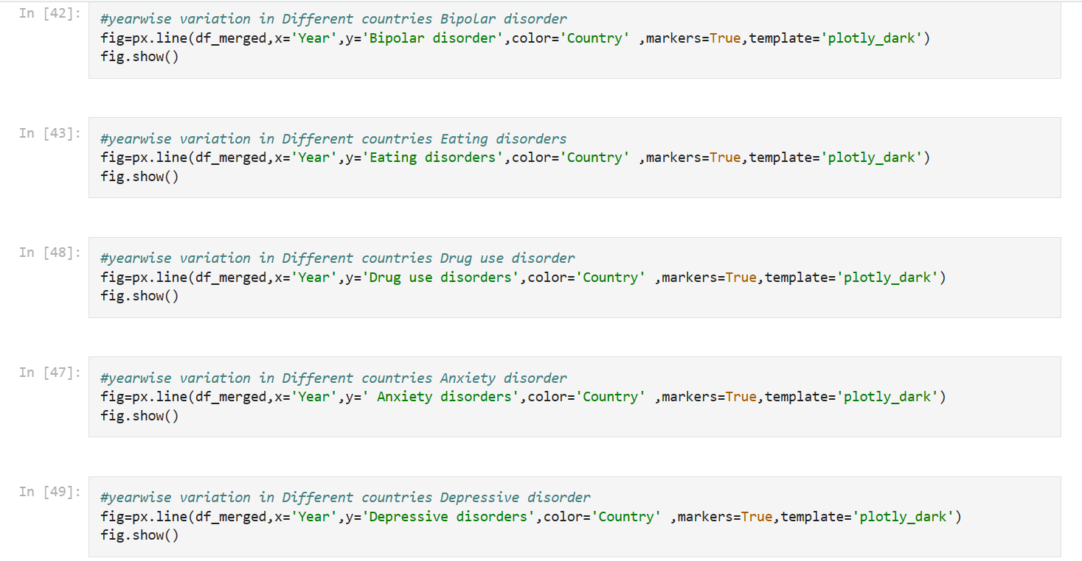

Slide 28
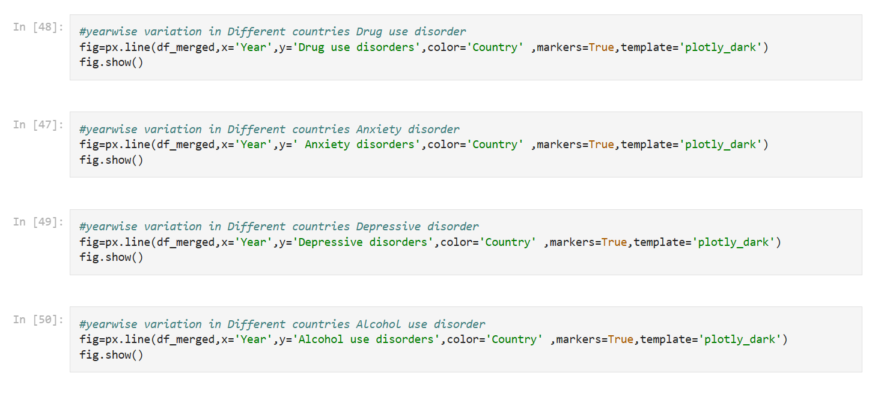

Slide 29
Results

Slide 31
The "Mental Fitness Tracker" project successfully analyzed mental health data and explored the impact of mental disorders on Disability-Adjusted Life Years (DALY) across different countries and time periods. Through data integration and visualization, we identified meaningful correlations between mental fitness-related factors and DALY, uncovering valuable insights into mental health trends.
By utilizing the Random Forest Regression model, we developed a predictive tool capable of estimating DALY based on selected mental fitness-related features. The model demonstrated promising accuracy during evaluation, indicating its potential to assist in mental health analysis and tracking.
The real-time tracking demonstration showcased the model's practicality in predicting mental fitness labels for new data points, underscoring its relevance in real-world applications.
Project Link: Shaishta-Anjum/Mental-Fitness-Tracker (github.com)

Slide 32
conclusion
The "Mental Fitness Tracker" project has provided valuable insights into mental health trends and the impact of mental disorders on DALY. The comprehensive analysis, visualizations, and machine learning techniques employed have enriched our understanding of mental well-being.
By sharing these findings with mental health professionals and policymakers, we aim to contribute to the development of effective strategies and interventions for improving mental health outcomes. Additionally, by promoting mental health awareness and reducing stigma, we aspire to foster a more compassionate and supportive society that values mental well-being.
As mental health continues to be a critical aspect of overall health, the "Mental Fitness Tracker" project serves as a stepping stone towards better mental health analysis, tracking, and advocacy. Our commitment to prioritizing mental fitness remains unwavering as we strive to create a healthier and more empathetic world for all individuals.

Slide 33
links
Project Link on GitHub:
Shaishta-Anjum/Mental-Fitness-Tracker (github.com)
Dataset used:
Mental Fitness Tracker (edunetworld.com)
Learning sources:
https://skills.yourlearning.ibm.com/activity/PLAN-E112D5AD3768

